Slide 1
Cloud Computing Basic
Valeria De Stasio SM3800074

Slide 2


Objectives of the project
Measure performances of a cluster deployed:
Using virtual machines (VirtualBox)
Using containers (Docker)
Compare the results and analyse them, providing a possible explanation

Slide 3
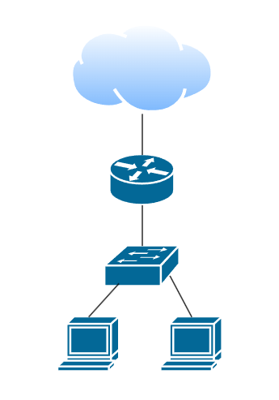
General Set Up
Internet
Host machine specifics:
8 cores
16 GB RAM
1 TB disk
Windows 11
Cluster nodes configuration:
2 CPUs
2 GB RAM
30 GB disk
192.168.56.1
192.168.56.2
192.168.56.3
Base address: 192.168.56.0/24
Broadcast: 192.168.56.255
Gateway: 192.168.56.1
First address: 192.168.56.2
Last address: 192.168.56.254
Netmask: 255.255.255.0
Wildcard: 0.0.0.255

Slide 4
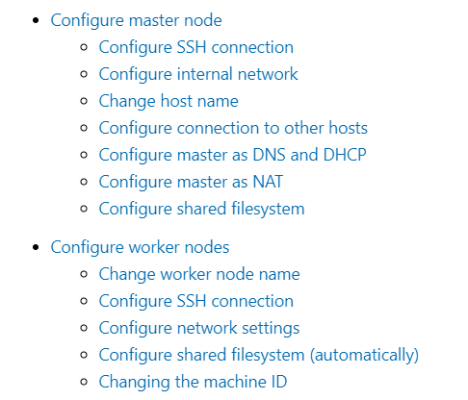
VMs
configuration
master node acting as:
NAT gateway
DHPC server
DNS server

Slide 5


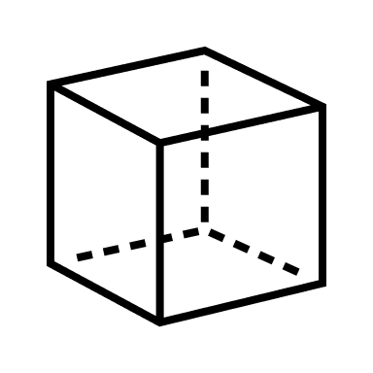
services:
master: (…)
node01: (…)
node02: (…)
Containers
configuration
master:
network:
- my_network
deploy:
resources:
limits:
cpus:’2’
memory: 2G
dockerfile
docker-compose.yaml
docker-compose build –d
docker image
docker exec -it Master bash
docker container

Slide 6
Chosen tests and configuration
mpirun -np 2 -hostfile hosts [test instruction]
HPCC
Sysbench
Stress-ng
IOZone
Iperf
Tests CPU and cluster performance
Tests CPU/memory performance
Tests system performance under stress
Tests disk I/O and storage performance
Tests network performance

Slide 7
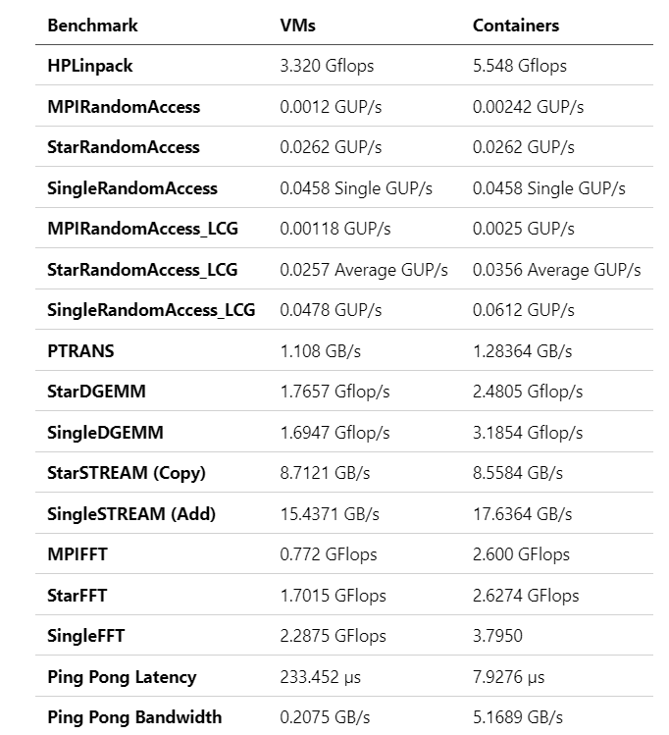
HPCC results
mpirun -np 2 -hostfile hosts hpcc
hpccinf.txt:
20352 Ns
1 Ps
2 Qs
CPU performance is higher for containers
Inter-node communication is more efficient in containers
Memory bandwidth shows slight improvement for containers
LCG = Linear Congruential Generator

Slide 8
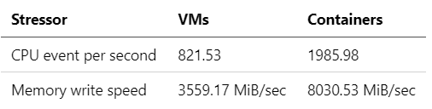
Sysbench results
mpirun -np 2 -hostfile hosts sysbench --test=cpu --cpu-max-prime=20000 run
mpirun -np 2 -hostfile hosts sysbench --test=memory --memory-total-size=10G run
Containers double the performance of VMs in both scenarios
--cpu-max-prime=20000: computes first 20000 prime numbers
--memory-total-size=10G: transfers 10G of data

Slide 9
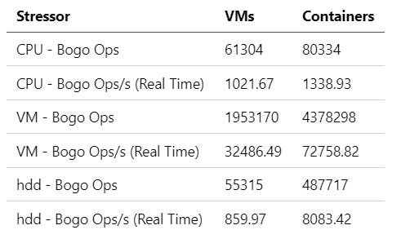
Stress-ng results
mpirun -np 2 -hostfile hosts stress-ng --cpu 2 --timeout 60s --metrics-brief
mpirun -np 2 -hostfile hosts stress-ng --vm 2 --vm-bytes 1G --timeout 60s --metrics-brief
mpirun -np 2 -hostfile hosts stress-ng --hdd 1 --timeout 60s --metrics-brief
High increment in virtual memory and hard disk drive operations
Slight increase in CPU operations

Slide 10
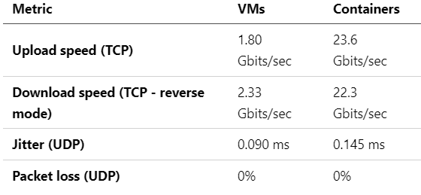
Iperf results
Master (server side)
Worker (client side)
iperf3 -c Master
iperf3 -c Master -u
iperf3 -c Master -R
iperf3 -s
Better connection speed for TCP connection
Similar connection speed for UDP connection

Slide 11
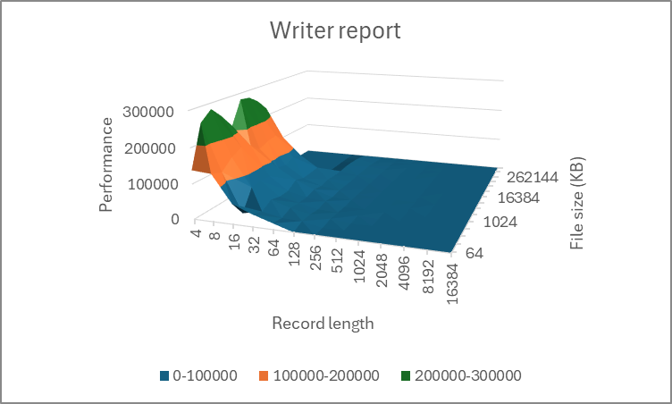
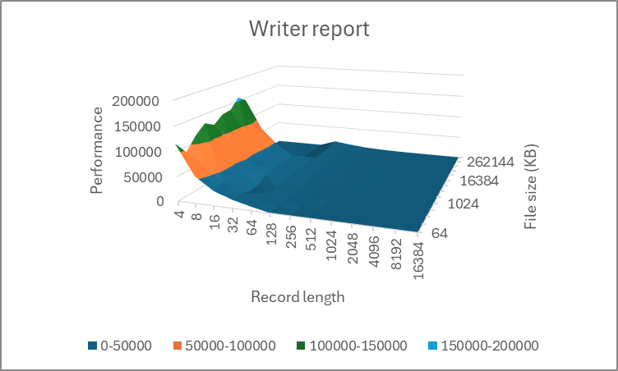
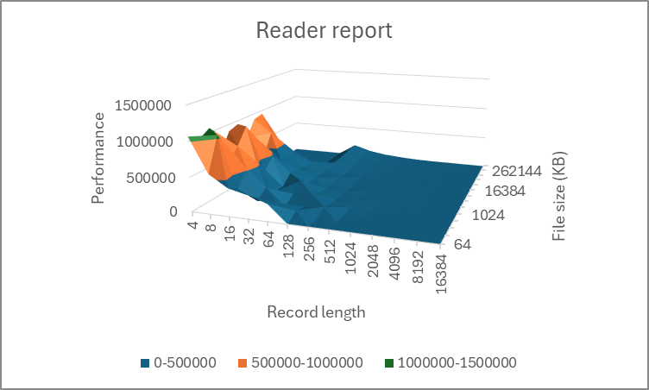
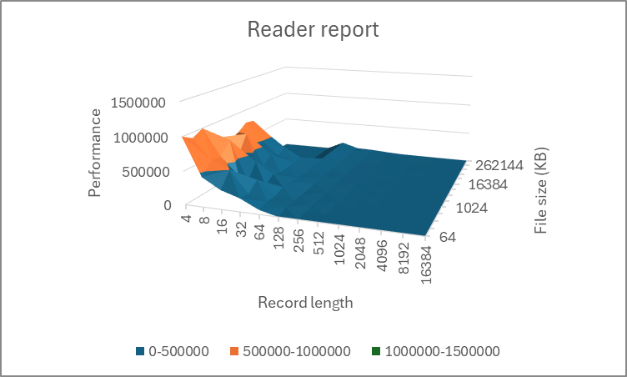
IOZone results
iozone -+m /shared/machines.txt -f /shared/testfile -a -R -O
Similar results for both VMs and containers
No visible four plateau
Maximum file size too small

Slide 12
Analysis and conclusion
The cluster obtained through containers achieved better results in CPU, memory and network tests: this is probably due to the absence of a virtualization overhead
Containers are lightweight and easier to deploy
Virtual machines still provide a better isolation

